Slide 1

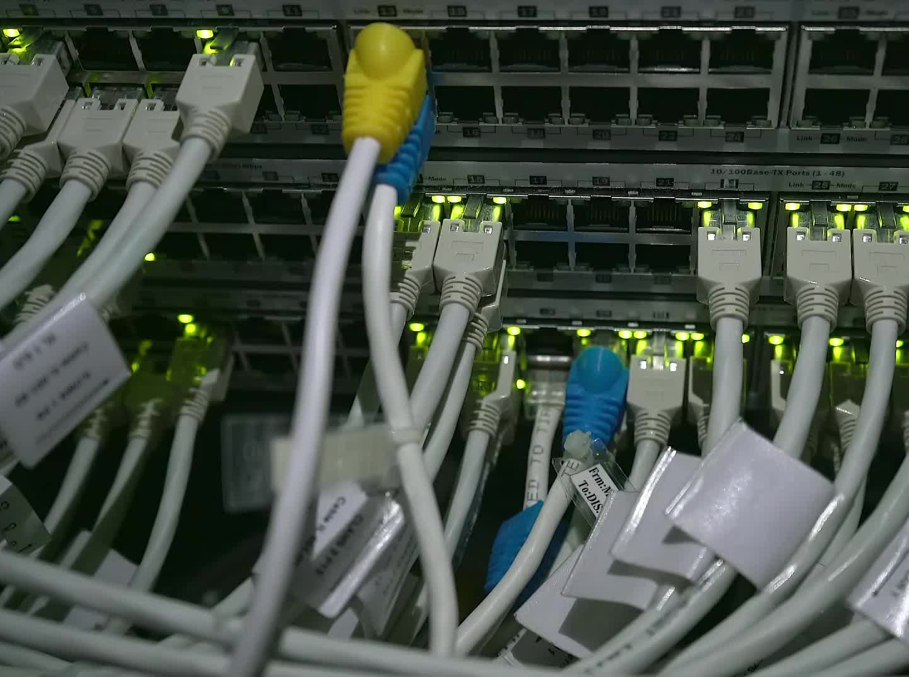


CS621 Parallel and Distributed Computing
Dr. Muhammad Anwaar Saeed
Dr. Said Nabi
Ms. Hina Ishaq

Slide 2
CS621 Parallel and Distributed Computing
What is Thread?

Slide 3
Objectives
Introduction of Threading.
Creating and Terminating Threads using POSIX API.

Slide 4
What is Thread?
In general
“A long, thin strand of cotton, fibers etc.,”
In Computing
“A sequence of linked instructions”
movl $14, %eax
movl $10, %ebx
add %eax, %ebx
Notes:
In general, from dictionary definition, a thread is a long, thin strand of cotton, fibers among others.
In computing, thread is defined as a sequence of linked instructions i.e., order collection of instruction that perform a particular task.
Line 1 in the example store the numeric value 14 into the general register eax
Line 2 store the numeric value 10 into the general register ebx
Line 3 add the values at eax and ebx and store the result in ebx

Slide 5
Threads in context of CPU Utilization:
“A thread is a basic unit of CPU utilization having…”
Thread ID
CPU Context
Stack
Priority
Errno.
Notes:
From CPU utilization point of view, a thread is defined as basic unit of CPU utilization which have their own unique thread ID, CPU context, each thread have priority, and Error number among others.

Slide 6


Threads in context of process
A thread is a piece of code within the process
Executes within the address space of a process
Lightweight process
Can be scheduled to run on a CPU as an independent unit and terminate
Multiple threads can run simultaneously .

Slide 7
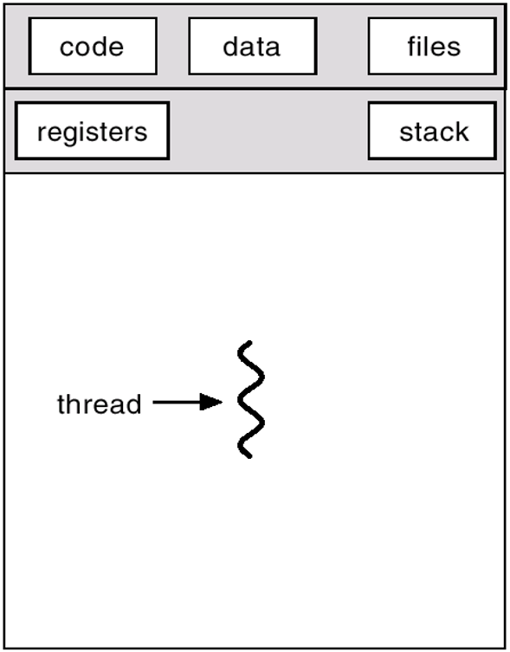
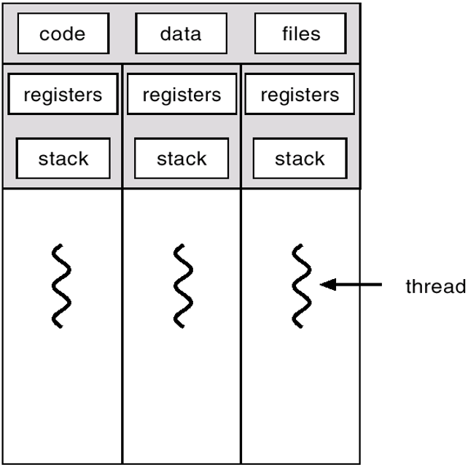
Single thread vs Multiple threads

Slide 8

Threads Example
Word Processor
  Another thread does periodic automatic backups of the file being edited
  Background thread may check spelling and grammar
  Foreground thread processes user input (keystrokes)
  A third thread loads images from the hard drive, and

Slide 9
Threads Example
Web Browser
Another thread retrieves data from the network
Web browser may have one thread to display images or text

Slide 10
CS621 Parallel and Distributed Computing
Thread Model?

Slide 11
Objectives
Introduction of Thread Model..
Logical Machine Model of Threads.

Slide 12
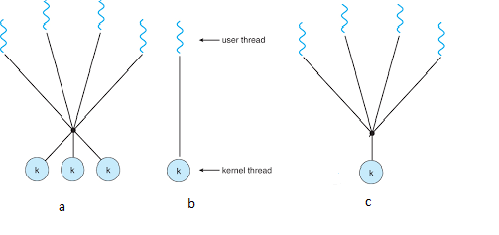
Thread Models
Many to Many
One to One
Many to One

Slide 13
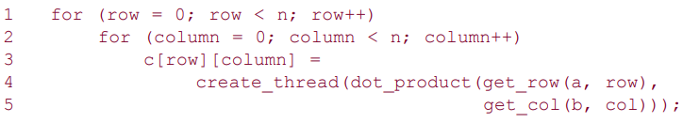
What is Thread?
Thread Example

Slide 14
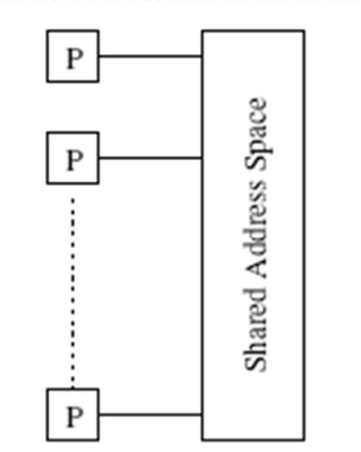
What is Thread?
All memory in the logical machine model of a thread is globally accessible to every thread

Slide 15
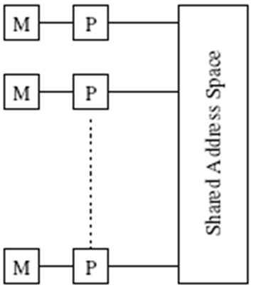
Logical Machine Model of Threads
Threads are invoked as function calls

Slide 16
CS621 Parallel and Distributed Computing
Thread API?

Slide 17
Objectives
What Is Thread API?
Thread Creation.

Slide 18
The POSIX Thread API
A number of vendors provide vendor-specific thread APIs (NT threads, Solaris threads, Java threads, etc.)
The IEEE specifies a standard 1003.1c-1995, POSIX API, also referred to as Pthreads
POSIX has emerged as the standard threads API, supported by most vendors.

Slide 19
Thread Termination
A pthread is represented by the type pthread_t.
terminates the thread and provides the pointer *value_ptr available to any pthread_join() call.
void pthread_exit(void *value_ptr);
int pthread_join(pthread_t thread,
void **value_ptr);
suspends the calling thread to wait for successful termination of the thread specified as the first argument pthread_t thread
An optional *value_ptr
data passed from the terminating thread's call to pthread_exit().

Slide 20
Thread Creation
A pthread is represented by the type pthread_t.
The actual thread object that contains pthread id
int pthread_create(pthread_t *thread,
pthread_attr_t *attr,
void *(*start_routine)(void *), void *arg);
Attributes to apply to this thread
The function this thread executes
Arguments to pass to thread function above

Slide 21
CS621 Parallel and Distributed Computing
Why Thread?

Slide 22
Objectives
Why Threads?
Characteristics of Threads.

Slide 23
Why Thread?
Portability:
The possibility to use the same software in different environments
Window XP
Work with
PC Game
Window 7
Window 10

Slide 24
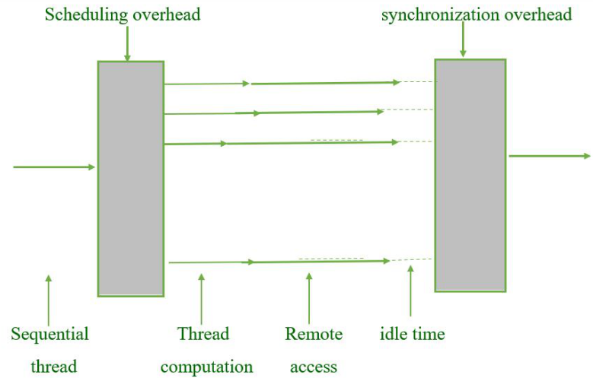
Why Threads Cont…
Latency hiding
Multithreading enables latency reduction/hiding

Slide 25
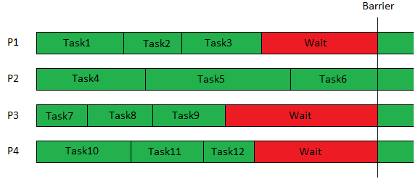
Why Threads Cont…
Scheduling and Load Balancing
Completed task execution and waiting for next task
P2 is still busy in executing the scheduled tasks

Slide 26
Why Thread?
Ease of Programming
Threaded programs are significantly easier to write than corresponding programs using message passing APIs.

Slide 27
Why Thread?
Widespread Use
The widespread acceptance of the POSIX thread API, development tools for POSIX threads are more widely available and stable.

Slide 28
CS621 Parallel and Distributed Computing
Thread Synchronization

Slide 29
Objectives
Introduction of Thread Synchronization
Logical Machine Model of Threads.

Slide 30


What is the biggest challenge with using thread?
Communication is implicit in shared-address-space programming.
Much of the effort associated with writing correct threaded programs is spent on synchronizing concurrent threads with respect to their data accesses or scheduling.

Slide 31
Synchronization
What will happen when multiple threads attempt to manipulate the same data item, if proper care is not taken to synchronize?
Can results incoherent

Slide 32
Synchronization Primitives of threads
Consider:
if (my_cost < best_cost)
best_cost = my_cost;
best_cost = 100
t1 = 50
t2 = 75
After time interval T, the best_cost =?

Slide 33
Mutual Exclusion
The code in the previous example corresponds to a critical segment; i.e.,
“A segment that must be executed by only one thread at any time”.
  Critical segments in Pthreads are implemented using mutex locks.
Mutex-locks have two states:.
  locked and
  Unlocked
  At any point of time, only one thread can lock a mutex lock.

Slide 34
Synchronization Primitives of threads
A lock is an atomic operation.
A thread entering a critical segment first tries to get a lock.
It goes ahead when the lock is granted

Slide 35
CS621 Parallel and Distributed Computing
Mutex Locks

Slide 36
Objectives
What are Mutex Locks?
Uses and types of mutex.

Slide 37
Mutual Exclusion
The Pthreads API functions for handling mutex-locks:
  int pthread_mutex_lock (pthread_mutex_t *mutex_lock);

Slide 38
Mutual Exclusion Cont…
The Pthreads API functions for handling mutex-locks:
int pthread_mutex_unlock (pthread_mutex_t *mutex_lock);

Slide 39
Mutual Exclusion Cont…
The Pthreads API functions for handling mutex-locks:
  int pthread_mutex_init ( pthread_mutex_t *mutex_lock, const pthread_mutexattr_t *lock_attr);

Slide 40

Producer-Consumer Using Mutex Locks
The producer-consumer scenario imposes the following constraints:
The producer thread must not overwrite the shared buffer when the previous task has not been picked up by a consumer thread.
The consumer threads must not pick up tasks until there is something present in the shared data structure
Individual consumer threads should pick up tasks one at a time.

Slide 41
Types of mutex
A normal mutex
A recursive mutex
Error check mutex

Slide 42
CS621 Parallel and Distributed Computing
Conditional Variable

Slide 43
Objectives
Problems with mutex
Introduction to conditional Variable.

Slide 44
Locking Overhead
Performance issue
Serialization issue

Slide 45
Locking overhead: Idling overheads
Int pthread_mutex_trylock ( pthread_mutex_t *mutex_lock);
It is often possible to reduce the idling overhead associated with locks using an alternate function, pthread_mutex_trylock.
pthread_mutex_trylock is typically much faster than pthread_mutex_lock on typical systems

Slide 46
Conditional Variable in Synchronization
Problem with trylock:
trylock introduces the overhead of polling for availability of locks.
Solution:
Condition Variable

Slide 47
What is conditional variable?
“A condition variable is a data object used for synchronizing threads. This variable allows a thread to block itself until specified data reaches a predefined state”,

Slide 48
Conditional Variable in Synchronization
A condition variable is associated with a predicate.
  When the predicate becomes true, the condition variable is used to signal one or more threads waiting on the condition.
A single condition variable may be associated with more than one predicate
A condition variable always has a mutex associated with it.

Slide 49
Conditional Variable Cont…
If the predicate is not true, the thread waits on the condition variable associated with the predicate using the function:
pthread_cond_wait.
A thread locks this mutex and tests the predicate defined on the shared variable.

Slide 50
Conditional Variable Cont…
Pthreads functions for condition variables
  int pthread_cond_wait(pthread_cond_t *cond, pthread_mutex_t *mutex);

Slide 51
Conditional Variable Cont…
Pthreads functions for condition variables
  int pthread_cond_signal(pthread_cond_t *cond);

Slide 52
Conditional Variable Cont…
Pthreads functions for condition variables
  int pthread_cond_init(pthread_cond_t *cond, const pthread_condattr_t *attr);
  int pthread_cond_destroy(pthread_cond_t *cond);

Slide 53
Conditional Variable Cont…
Pthreads functions for condition variables
  int pthread_cond_broadcast(pthread_cond_t *cond);

